Slide 1

Deep Learning [21DS611] Application of PINN on fluid flow prediction
22-04-2024
Presented by: Sandra.S
Amrita School of AI

Slide 2
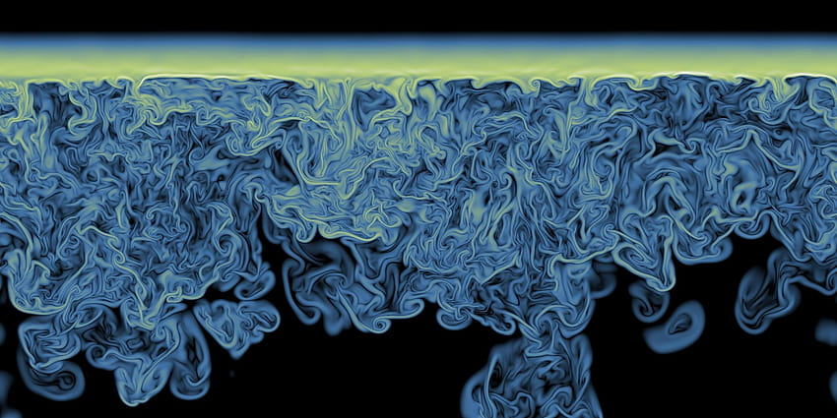
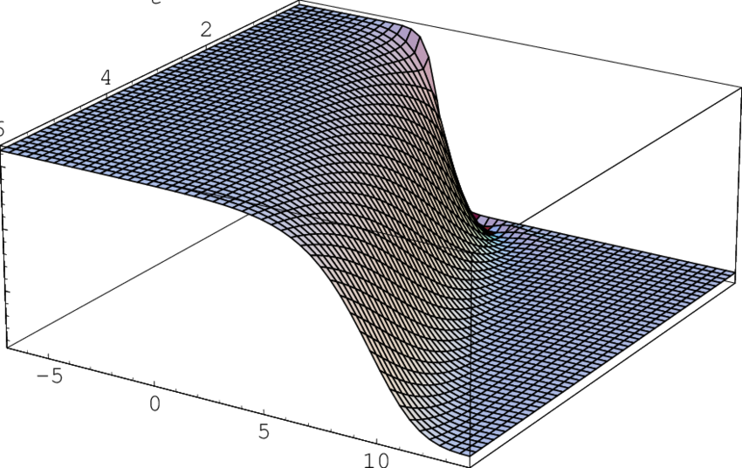










$$\frac{∂u}{∂t}+u\frac{∂u}{∂x}=v\frac{∂^{2}u}{∂x^{2}}$$
https://www.bing.com/images/search?view=detailV2&ccid=qwnMou%2f6&id=469FC11744448FD62F467B6276BBD804E0AA6AAC&thid=OIP.qwnMou_6XawvApc1do-CWQHaEq&mediaurl=https%3a%2f%2fwww.researchgate.net%2fprofile%2fAv-Porubov%2fpublication%2f267106464%2ffigure%2ffig3%2fAS%3a392252007436319%401470531574339%2fSmoothness-of-the-initial-Burgers-shock-wave.png&exph=536&expw=850&q=Burgers+Shock+Wave&simid=608000798109479321&FORM=IRPRST&ck=14D8B084E11F603E2B908371E17927F8&selectedIndex=3&itb=1

Slide 3
By solving the Burgers' equation we can explore and understand the behavior of complex fluid flows more effectively.
Approaches to solve partial differential equation
Analytic Solution (for solving simple PDE’s)
Finite difference method
Neural network based approach
1998,Lagris et.al.,IEEE Trans.Neural Networks
2019,Raissi et.al., Journal of Computational Physics

Slide 4
Objective of Implementing PINN
Explore and understand complex fluid dynamics more effectively.
Discover intricate patterns and dynamics emerging from underlying physics.
Benefits of Using PINN for Burgers' Equation
Testbed for demonstrating efficacy of Physics-Informed Neural Networks (PINN) in solving nonlinear PDEs.
Paves way for broader applications in computational physics and engineering.

Slide 5
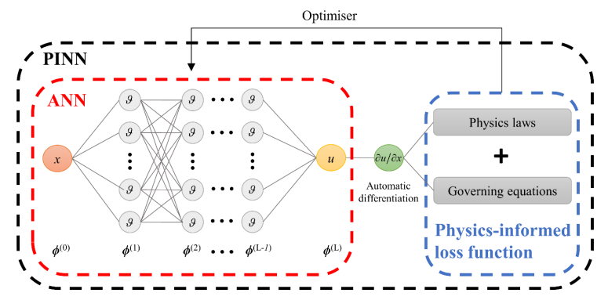
arxiv.org/ftp/arxiv/papers/2210/2210.09060.pdf

Slide 6
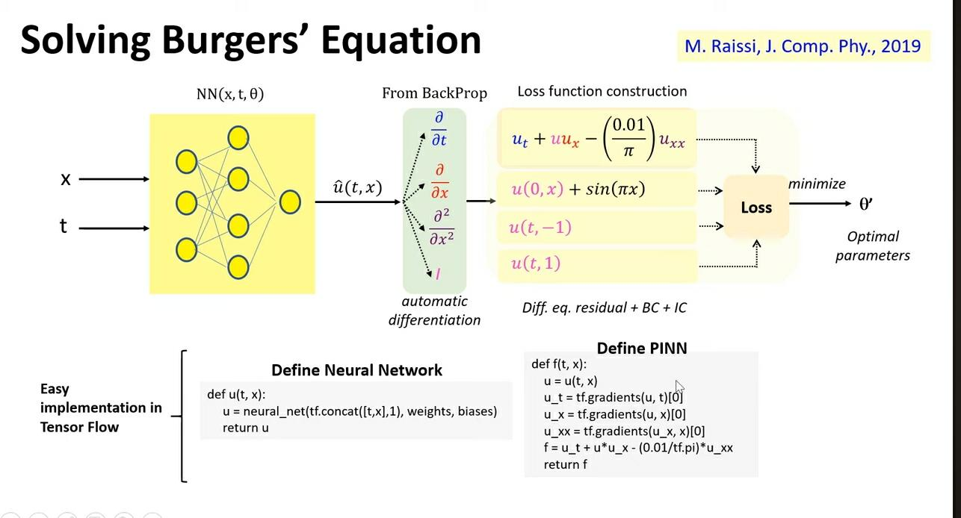
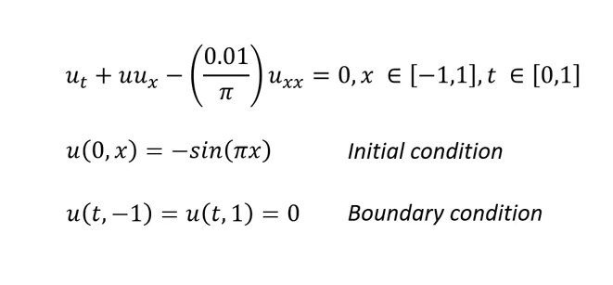
Methodology: Solving Burgers Equation
Data Preparation
Problem Formulation
Formulated using DeepXDE library
3 hidden layers , 20 neurons
Hyperbolic tangent
Boundary and Initial Conditions
Training and Optimization: ADAM Optimiser(LEARNING RATE-1E-3) and L-BFGS
Evaluation and Analysis

Slide 7
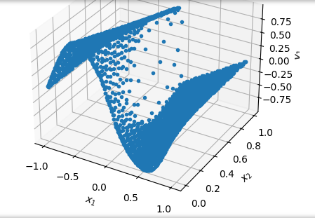
PRELIMINARY RESULTS
Mean residual: 0.0184856
L2 relative error: 0.0474309992936375

Slide 8
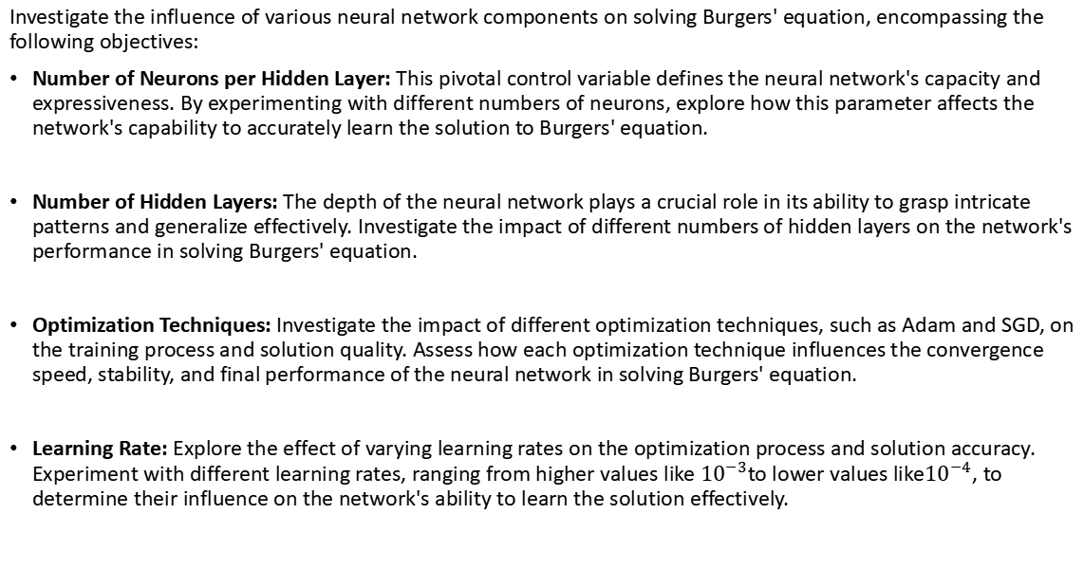
Objectives
Investigate the influence of various neural network components on solving Burgers' equation, encompassing the following objectives:
Number of Neurons per Hidden Layer: This pivotal control variable defines the neural network's capacity and expressiveness. By experimenting with different numbers of neurons, explore how this parameter affects the network's capability to accurately learn the solution to Burgers' equation.
Number of Hidden Layers: The depth of the neural network plays a crucial role in its ability to grasp intricate patterns and generalize effectively. Investigate the impact of different numbers of hidden layers on the network's performance in solving Burgers' equation.
Optimization Techniques: Investigate the impact of different optimization techniques, such as Adam and SGD, on the training process and solution quality. Assess how each optimization technique influences the convergence speed, stability, and final performance of the neural network in solving Burgers' equation.
Learning Rate: Explore the effect of varying learning rates on the optimization process and solution accuracy. Experiment with different learning rates, ranging from higher values like ${10}^{−3}$to lower values like${10}^{−4}$, to determine their influence on the network's ability to learn the solution effectively.

Slide 9
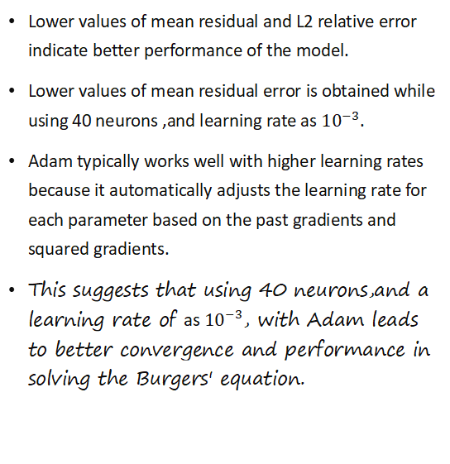
Adam Optimiser- Mean Residual
Lower values of mean residual and L2 relative error indicate better performance of the model.
Lower values of mean residual error is obtained while using 40 neurons ,and learning rate as ${10}^{−3}$.
Adam typically works well with higher learning rates because it automatically adjusts the learning rate for each parameter based on the past gradients and squared gradients.
This suggests that using 40 neurons,and a learning rate of as ${10}^{−3}$, with Adam leads to better convergence and performance in solving the Burgers' equation.

Slide 10
ADAM- L2 Relative error
a lower learning rate can cause the model to learn too slowly.
.
There is a trend of increasing L2 relative error with decreasing learning rate. This trend is consistent across all three hidden layer configurations ([20, 20, 20], [30, 30, 30] and [40, 40, 40]).
A lower learning rate can cause the model to learn too slowly. This means that the model may converge on a solution that is not the optimal solution.

Slide 11
SGD – Mean relative error
As we increase the number of neurons in each layer, the mean residual error generally decreases. This indicates that increasing the model's complexity by adding more neurons allows it to better fit the training data, resulting in lower residual errors.
Works better for smaller learning rates.

Slide 12

SGD-L2 Relative error
On increasing the number of neurons there is’nt much variation.
Learning rate ${10}^{−3}$

Slide 13
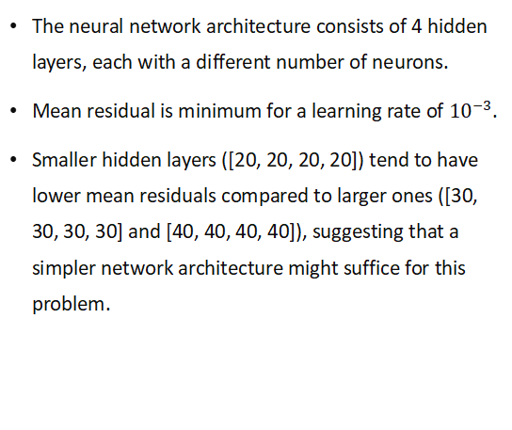
ADAM- 4 hidden layers
The neural network architecture consists of 4 hidden layers, each with a different number of neurons.
Mean residual is minimum for a learning rate of ${10}^{−3}$.
Smaller hidden layers ([20, 20, 20, 20]) tend to have lower mean residuals compared to larger ones ([30, 30, 30, 30] and [40, 40, 40, 40]), suggesting that a simpler network architecture might suffice for this problem.

Slide 14
Results and Discussion
Configuration:
Optimizer: ADAM
Learning Rate: 0.001 (10^-3)
Hidden Layers: 3 layers with 40 neurons each ([40, 40, 40])
Optimizer Selection: We chose ADAM as the optimizer due to its effectiveness in optimizing deep neural networks. By adaptively adjusting the learning rates for each parameter, Adam can efficiently navigate the loss landscape and converge to the optimal solution more quickly.
Learning Rate: A learning rate of 0.001 was chosen based on empirical observations during our comparative study. This learning rate strikes a balance between convergence speed and stability, allowing the model to learn the underlying patterns effectively.
Hidden Layers: While experimenting with different numbers of hidden layers and neurons, we found that a relatively simpler configuration with 3 hidden layers and 40 neurons each yielded satisfactory results.

Slide 15
Future Directions:
Further experimentation and fine-tuning of hyperparameters could potentially improve the model's performance.
Investigating alternative neural network architectures and optimization strategies may provide additional insights into solving the Burgers' equation more efficiently.
Exploring regularization techniques and advanced learning rate scheduling methods could help enhance the robustness and convergence speed of the model.

Slide 16
References
[1] Raissi M, Yazdani A, Karniadakis GE, Hidden fluid mechanics: Learning velocity and pressure fields from flow visualizations, Science 367, 1026–1030
[2] Ameya D. Jagtap , Ehsan Kharazmi , George Em Karniadakis , Conservative physics-informed neural networks on discrete domains for conservation laws: Applications to forward and inverse problems, Computer Methods in Applied Mechanics and Engineering ,Volume 365, 15 June 2020, 113028
[3] Jian Cheng Wong, Chinchun Ooi, Pao-Hsiung Chiu, My Ha Dao, Improved Surrogate Modeling of Fluid Dynamics with Physics-Informed Neural Networks, arXiv:2105.01838
[4] Hassan Bararnia , Mehdi Esmaeilpour, On the application of physics informed neural networks (PINN) to solve boundary layer thermal-fluid problems , International Communications in Heat and Mass Transfer 132 (2022) 105890.
[5] Burgers equation — DeepXDE 1.11.1.dev13+g862b67f documentation

Slide 17

THANK YOU

